Slide 1
2024 SIAG/SC
SIAM Conference on Parallel Processing for Scientific Computing
Supercomputing Business Meeting
Thursday, March 7th^{th}, 6-6:45pm EST

Slide 2
SIAG/SC Officers
Chair:
Ulrike Yang
*
Vice Chair:
Rio Yokota
*
Program Director:
Hartwig Anzt
*
Secretary:
Erin Carson

Slide 3
SIAG/SC Thank you to the 2022-23 Officers
Chair:
Lois Curfman McInnes
*
Vice Chair:
Hatem Ltaief
*
Program Director:
Michael Bader
*
Secretary:
Rio Yokota

Slide 4
SIAG/SC Announcements
SIAM Engage
https://engage.siam.org/communities/siag-sc-home?CommunityKey=4f08fa5b-1e64-4855-9453-1f67059976d9
SIAG/SC websites:
https://www.siam.org/membership/activity-groups/detail/supercomputing
SIAM Blogs
SIAM News: Story Ideas
SIAG/SC Leadership Suggestion Form:
https://www.siam.org/forms/siam-activity-group-leadership-form

Slide 5
SIAG/SC Fellows
Class of 2022
Class of 2023
James Crowley
George Biros
Ali Pinar
Sivan Toledo

Slide 6
SIAG/SC Conference History

Slide 7
SIAG/SC Parallel Processing Conference 2024
Organizing Committee Co-Chairs
Michael Bader, Technische Universität München, Germany Anshu Dubey, Argonne National Laboratory, U.S.
Organizing Committee
Hartwig Anzt, University of Tennessee, U.S. Paolo Bientinesi, Umeå University, Sweden Aparna Chandramowlishwaran, University of California, Irvine, U.S. Laura Grigori, EPFL, Switzerland Jeff Hammond, NVIDIA, Finland Jaejin Lee, Seoul National University, Republic of Korea Bethany Lusch, Argonne National Laboratory, U.S. Karla Morris, Sandia National Laboratories, U.S. Johann Rudi, Virginia Tech, U.S. Tetsuya Sakurai, University of Tsukuba, Japan
Steering Committee
George Biros, University of Texas at Austin, U.S. Lois Curfman McInnes, Argonne National Laboratory, U.S. Sherry Li, Lawrence Berkeley National Laboratory, U.S. Hatem Ltaief, KAUST, Saudi Arabia Keita Teranishi, Oak Ridge National Laboratory, U.S. Ulrike Meier Yang, Lawrence Livermore National Laboratory, U.S. Rio Yokota, Tokyo Institute of Technology, Japan

Slide 8
SIAG/SC Parallel Processing Conference 2024
Proceedings Paper Committee
Prasanna Balaprakash, Oak Ridge National Laboratory Grey Ballard, Wake Forest University Costas Bekas, Citadel Securities Luc Berger-Vergiat, Sandia National Laboratories Aurelien Bouteiller, University of Tennessee Knoxville Jee Choi, University of Oregon Aditya Devarakonda, Wake Forest University Edoardo Angelo Di Napoli, Forschungszentrum Jülich Nikoli Dryden, ETH Zurich Wilfried Gansterer, University of Vienna David Gardner, Lawrence Livermore National Laboratory Oded Green, NVIDIA/Georgia Institute of Technology Scott Klasky, Oak Ridge National Laboratory Alicia Klinvex, Naval Nuclear Laboratory Wookeun Jung, Moreh Inc.
Jiajia Li, North Carolina State University Yang Liu, Lawrence Berkeley National Laboratory Hatem Ltaief, King Abdullah University of Science and Technology Tanu Malik, DePaul University Christoph Niethammer, HRLS, Universität Stuttgart Dirk Pflüger, Universität Stuttgart Damian Rouson, Lawrence Berkeley National Laboratory Ilya Safro, University of Delaware John Shalf, Lawrence Berkeley National Laboratory Michelle Strout, Hewlett Packard Enterprise (HPE) Eric de Sturler, Virginia Tech Stanimire Tomov, University of Tennessee Knoxville Bora Ucar, CNRS and LIP ENS Lyon Emil Vatai, Riken R-CCS Stefano Zampini, King Abdullah University of Science and Technology

Slide 9
SIAG/SC Parallel Processing Conference 2024
SIAG/SC Best Paper Prize
Accelerating Sparse Iterative Solvers and Preconditioners Using RACE
Thursday, March 7th 8:30-9:10 AM EST
The sparse matrix-vector multiplication (SpMV) kernel is a key performance-limiting component of numerous algorithms in computational science. Despite the kernel’s apparent simplicity, the sparse and potentially irregular data access patterns of SpMV and its intrinsically low computational intensity have been challenging the development of high-performance implementations of sparse algorithms over decades.
In this talk, we present methods to increase the computational intensity and thereby accelerate the performance of SpMV kernels. The method is based on the concept of levels as developed in the context of our RACE library framework. We demonstrate that one can typically achieve a speedup of 1.5-4x on a single modern Intel or AMD multicore chip for symmetric SpMV and matrix power kernels using this level-based approach. After briefly introducing the optimization strategy, we apply these optimized kernels in iterative solvers. To this end, we discuss the coupling of the RACE library with the Trilinos framework and address the application to communication-avoiding s-step Krylov solvers, polynomial preconditioners, and algebraic multigrid (AMG) preconditioners. We then dive into the performance benefits and challenges of the RACE integration and show that our optimization produces numerically identical results and improves the total solver time by 1.3x - 2x.
Christie Alappat, Friedrich-Alexander-Universität Erlangen-Nürnberg, Germany Achim Basermann, German Aerospace Center (DLR), Germany Alan R. Bishop, Los Alamos National Laboratory, U.S. Holger Fehske, University of Greifswald, Germany
Georg Hager, Friedrich-Alexander-Universität Erlangen-Nürnberg, Germany Olaf Schenk, Università della Svizzera italiana, Switzerland Jonas Thies, Delft University of Technology, The Netherlands Gerhard Wellein, Friedrich-Alexander-Universität Erlangen-Nürnberg, Germany

Slide 10
SIAG/SC Parallel Processing Conference 2024
SIAG/SC Early Career Prize
Scalability and Productivity in Data-Intensive Biological Research on Massively Parallel Systems
Thursday, March 7th, 9:10-9:50 AM EST
The use of massively parallel systems continues to be critical for processing large volumes of data at an unprecedented speed and for scientific discoveries in simulation-based research areas. Today, these systems play a crucial role in new and diverse areas of data science, such as computational biology, deep learning, and data analytics. Computational biology is a key area of the rapid growth of computing. The growing volume of data and increasing complexity have outpaced the processing capacity of single-node machines in these areas, making massively parallel systems an indispensable tool. The diverse and non-trivial challenges of parallelism in these areas require computing infrastructures that go beyond the demand of traditional simulation-based sciences.
However, programming on high-performance computing (HPC) systems poses significant productivity and scalability challenges. It is important to introduce an abstraction layer that provides programming flexibility and productivity while ensuring high system performance. It is then important to map and plan the abstracted computation and communication to the underlying system to achieve optimal performance and guide the design of future large-scale architectures. As we enter the post-Moore's Law era, effective programming of specialized architectures is critical for improved performance in HPC. As large-scale systems become more heterogeneous, their efficient use for new, often irregular, and communication-intensive data analysis computation becomes increasingly complex. In this talk, we discuss how to achieve performance and scalability on extreme-scale systems while maintaining productivity for new data-intensive biological challenges, through an appropriate high-performance abstraction, namely the use of sparse matrices as well as the use of novel heterogeneous hardware.
Giulia Guidi Cornell University and Lawrence Berkeley National Laboratory, U.S.

Slide 11
SIAG/SC Parallel Processing Conference 2024
SIAG/SC Career Prize
Tackling High Dimensional Problems Through Randomization and Communication Avoidance
Thursday, March 7th, 9:50-10:30 AM EST
Laura Grigori
EPFL and PSI, Switzerland

Slide 12
SIAG/SC Parallel Processing Conference 2024
SIAG/SC Prizes
Best Paper Prize Career Prize Early Career Prize
Next Call for Nominations Opens: March 1, 2025
At least 3 new nominations are required for an award to be given within a prize cycle.
Any SIAM-sponsored prize which receives less than three new nominations to an open call for nominations will not be awarded in that cycle. In the case that the prize is skipped for one cycle, any nominations that were received and remain eligible will be carried over to the next cycle. Carryovers do not count for the purposes of meeting minima for new nominations. But if nominators revise the package, it is then counted as a new nomination.
Help SIAG/SC honor outstanding contributions in the field of parallel scientific and engineering computing by nominating qualified individuals!
For more information visit: https://www.siam.org/prizes-recognition/policies-guidelines/detail/prizes-and-recognition

Slide 13
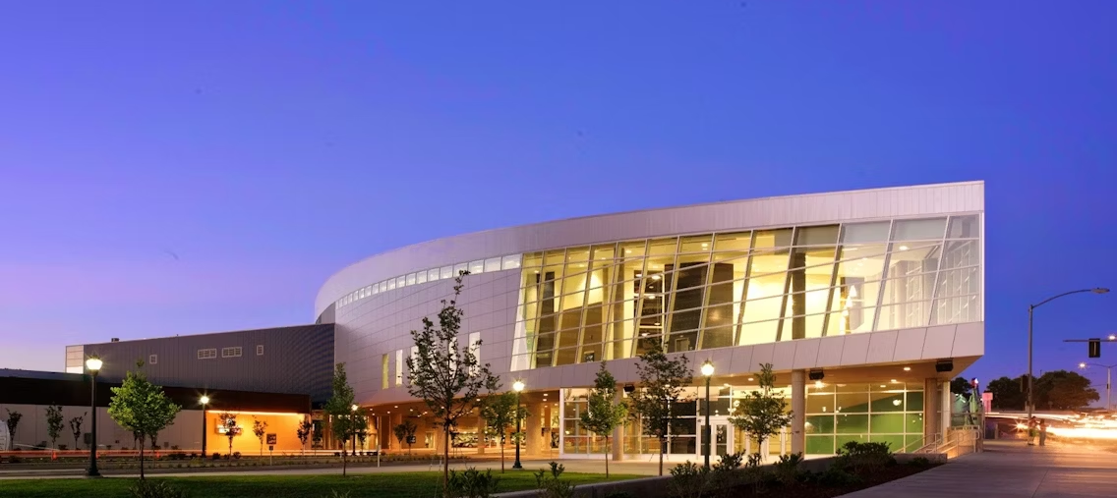
July 8th – July 12th, 2024
Spokane Convention Center
Spokane, Washington, U.S.
The Annual Meeting provides a broad view of the state of the art in applied mathematics, computational and data science, and their applications through invited presentations, prize lectures, minitutorials, minisymposia, contributed presentations, and posters.
The 2024 online component will take place July 18th-20th
Organizing Committee Co-Chairs
Michael P. Friedlander, University of British Columbia, Canada Anna Mazzucato, Pennsylvania State University, U.S.

Slide 14
July 8th – July 12th, 2024
Spokane Convention Center
Spokane, Washington, U.S.
Held Jointly with:
SIAM Conference on Discrete Mathematics (DM24)
SIAM Conference on Applied Mathematics in Education (ED24)
Tracks of Sessions by SIAM SIAGs:
Dynamical Systems
Registration Deadline:
June 10th, 2024
Hotel Registration Deadline:
June 10th, 2024
Travel Fund Application Deadline:
April 8th, 2024
Online component July 18th-20th
More information available at:
https://www.siam.org/conferences/cm/conference/an24

Slide 15
Gene Golub SIAM Summer School
Iterative and Randomized Methods for Large-Scale Inverse Problems
July 22nd - August 2nd 2024
Campus of the Escuela Politécnica Nacional, Ladrón de Guevara E11-253, Quito, Ecuador.
Our Summer School will enable students to learn state-of-the-art mathematical and statistical tools to discover information hidden within large-scale data sets and solve complex inverse problems. Through hands-on experience with techniques from Randomized Numerical Linear Algebra, data assimilation, iterative algorithms, and inverse problems we will offer students a two-week summer school to learn this valuable range of computational mathematics topics.
For more information visit: https://www.siam.org/students-education/programs-initiatives/gene-golub-siam-summer-school

Slide 16
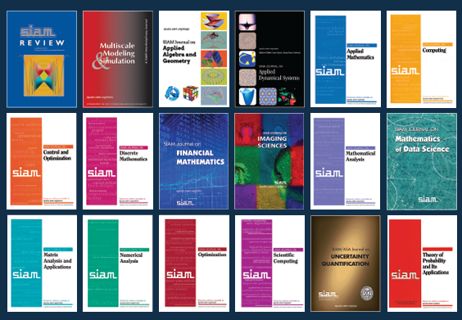
SIAM Journals
SIAM’s 18 journals are all available for download on the SIAM Publications Library (epubs.siam.org), which offers the definitive source for the final, peer-reviewed version of every published article - so be sure to utilize it!
Questions about using epubs.siam.org? Contact service@siam.org for a user guide and personal assistance!

Slide 17
Future conferences?
Location
Timing
Program committee
Notes:
SIAG/SC track at SIAM AM25 in Montreal

Slide 18
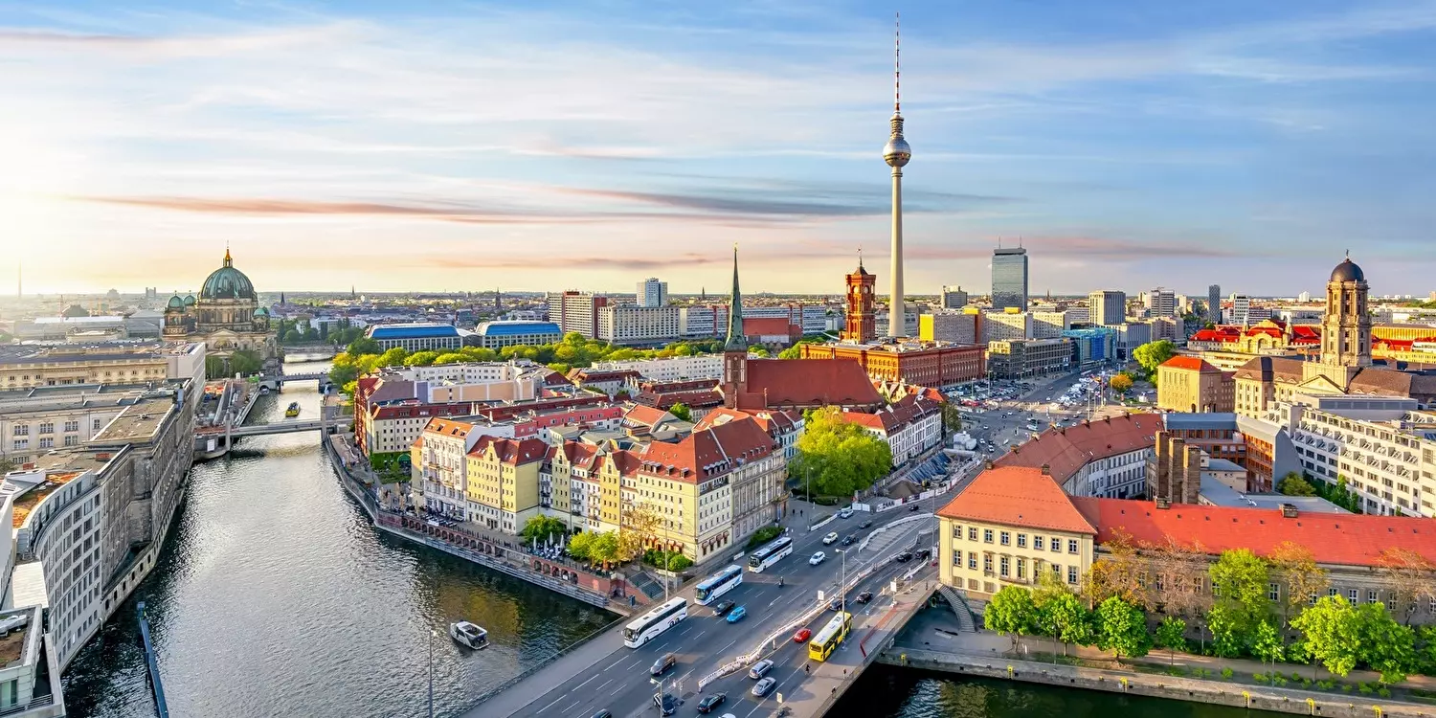
SIAM PP 2026 Proposal
Berlin, Germany

Slide 19
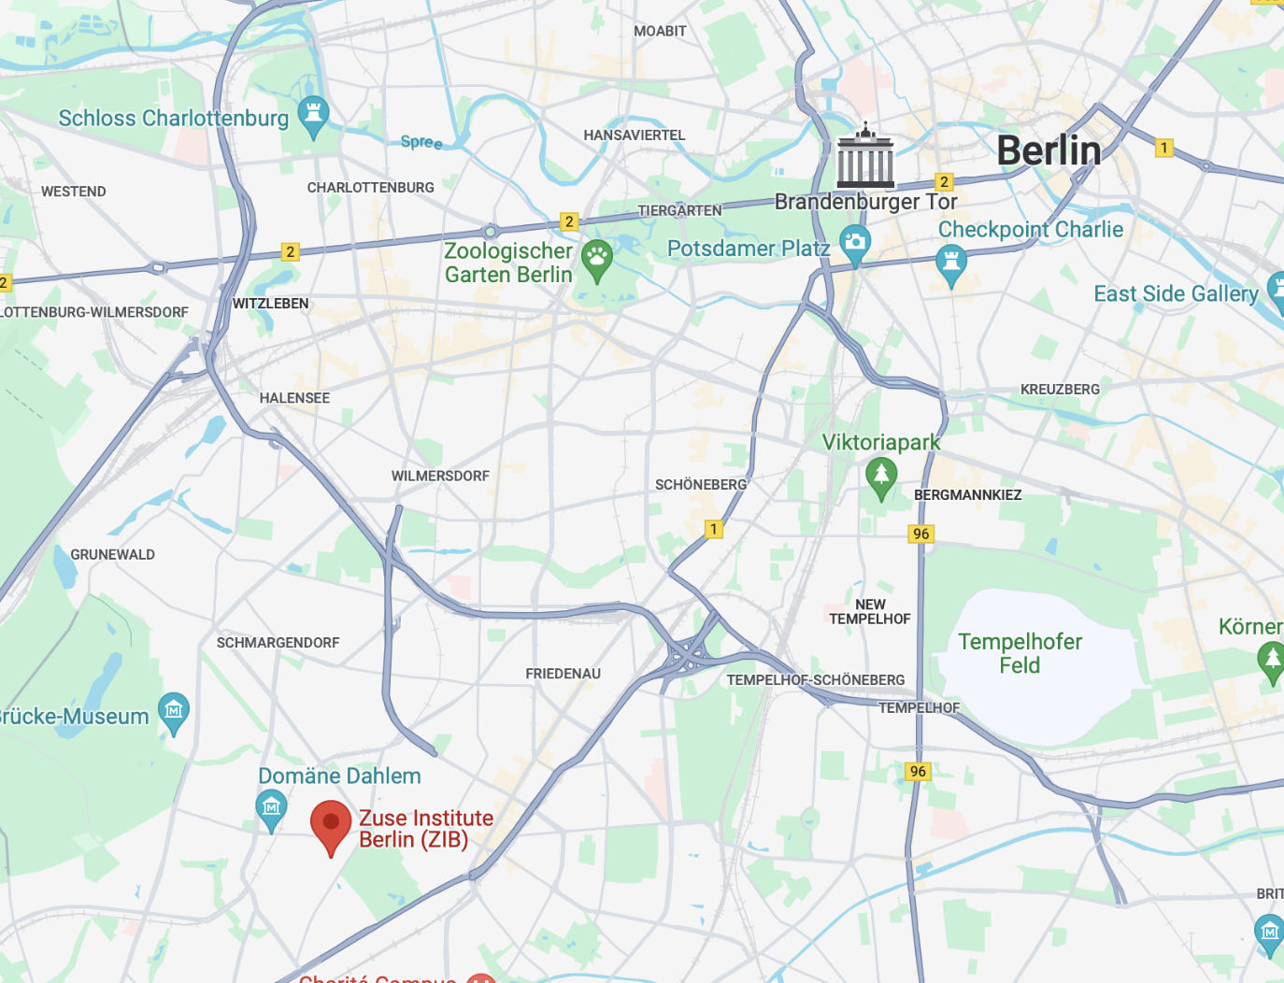
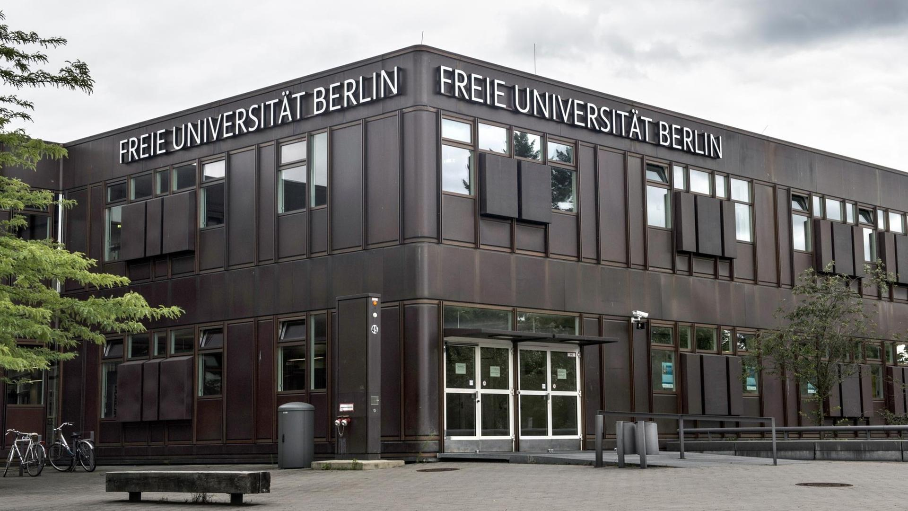
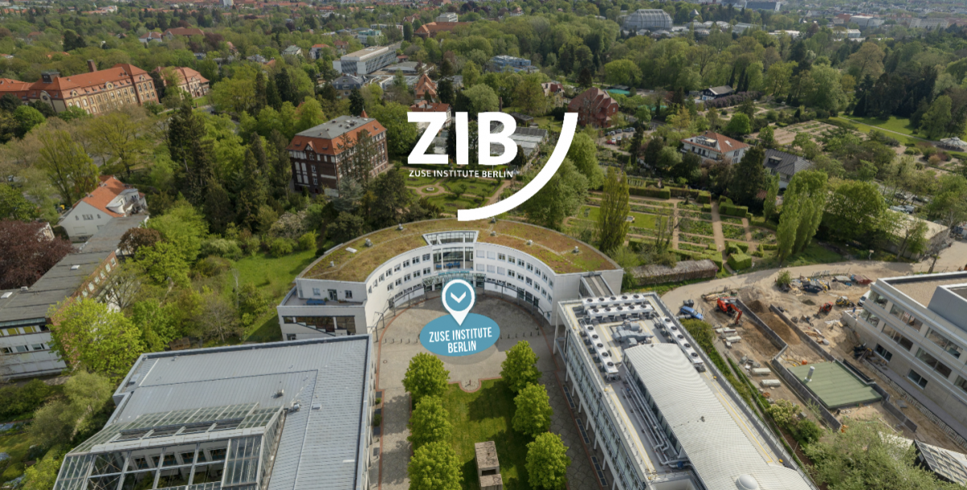
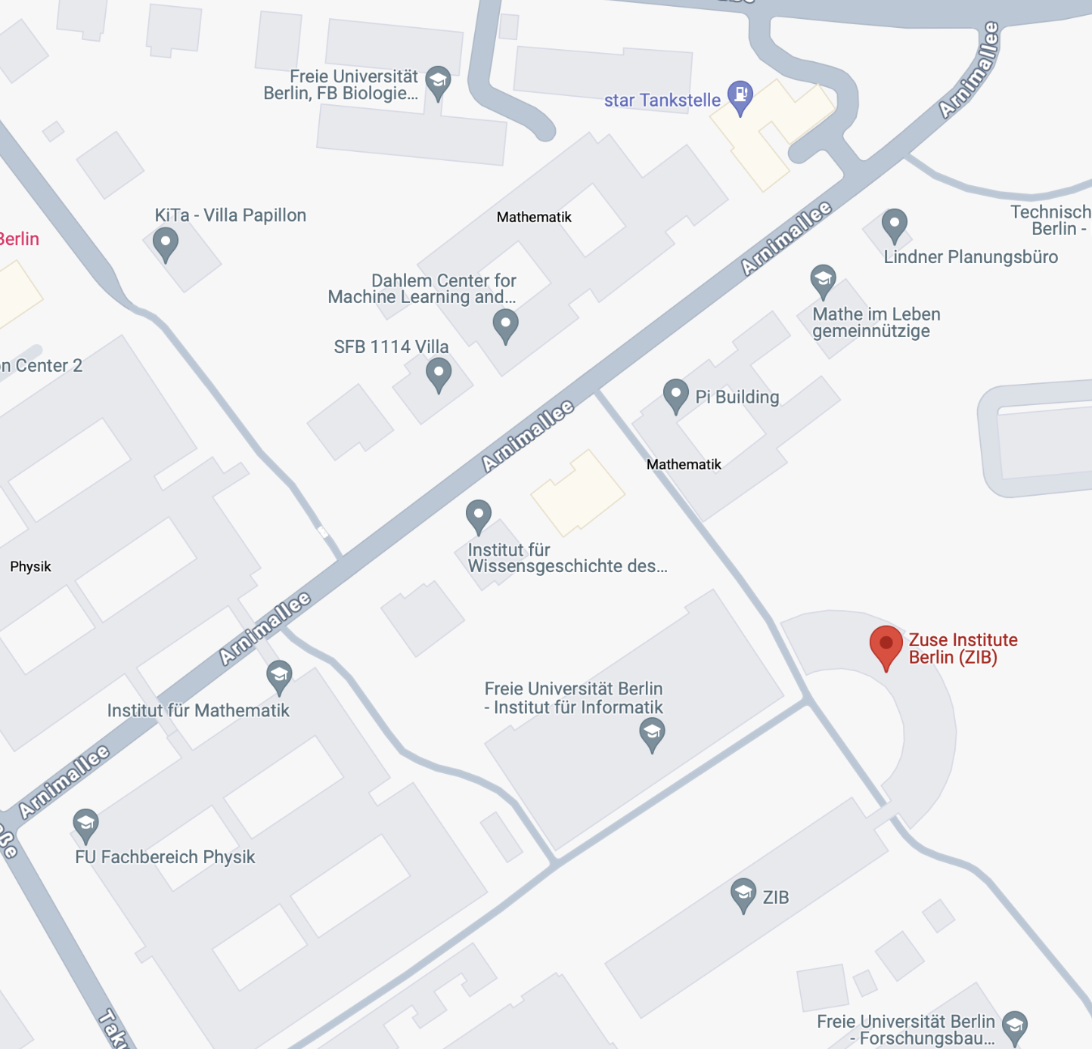
Location
Freie Universität Berlin (FU Berlin) & Zuse Institute Berlin

Slide 20
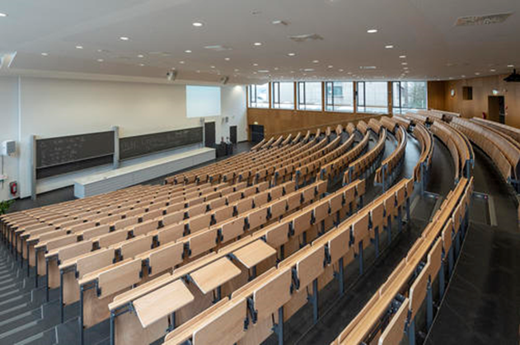
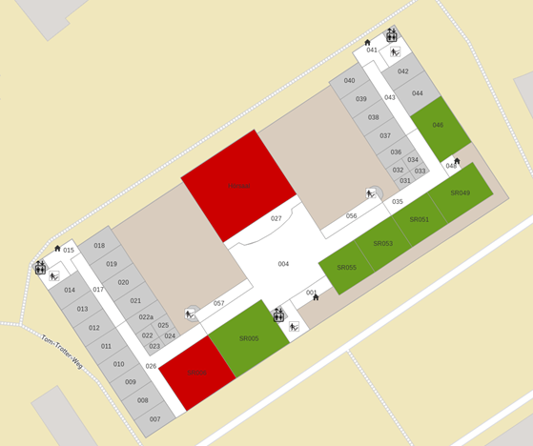
Amenities
Biology Big Lecture Hall (550 seats)
Biology Lecture Hall A (200 seats)
Computer Science Lecture Hall (200 seats)
Zuse Institute Lecture Hall (159 seats)
Mathematics Lecture Hall (123 seats)
Biology Lecture Hall B (100 seats)
Computer Science Seminar Room SR005 (70 seats)
Computer Science Seminar Room SR006 (50 seats)
Computer Science Seminar Room SR049 (40 seats)
Computer Science Seminar Room SR046 (40 seats)
Computer Science Seminar Room SR055 (32 seats)
Computer Science Seminar Room SR053 (30 seats)
Computer Science Seminar Room SR051 (30 seats)
Zuse Institute Seminar Room (40 seats)
• Computer Science Foyer (200 m², ca 70 attendees) • Zuse Institute Foyer (209 m², ca 75 attendees) • Biology Foyer (450 m², ca 250 attendees)
Keynotes
Plenary sessions
Minisymposia

Slide 21
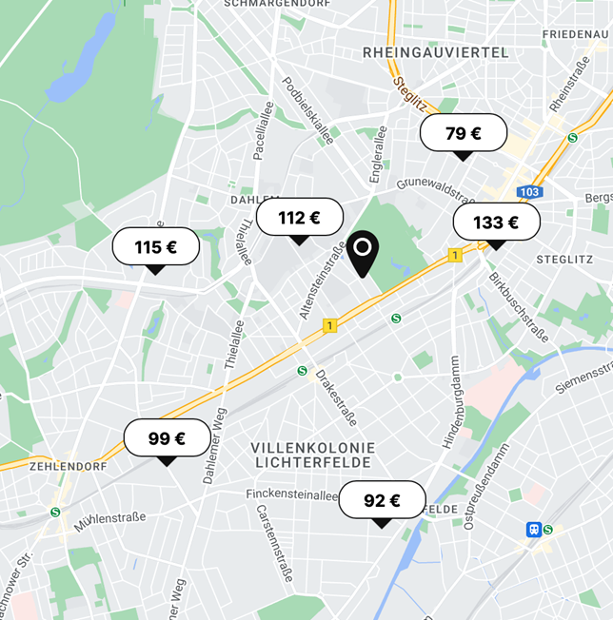
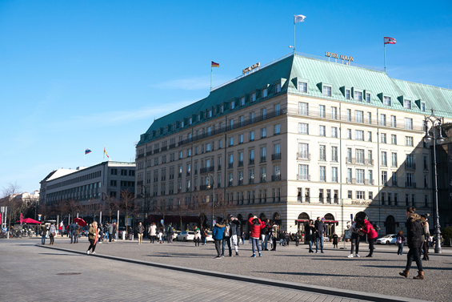
Housing
Neighborhood
Seminaris Campus Hotel 150€
Steglitz International 120€
Pension Dahlem 95€
City
B&B City West 140€
Castell am Kurfürstendamm 110€
Premier Inn 145€
SANA Berlin 200€
Palace 240€
Double Tree Hilton 250€
many more…

Slide 22
Join SIAM Today!
Benefits of SIAM Membership Include………
SIAM Review (Print & Electronic)
SIAM News (Print)
30% Off SIAM Books
$15 / Activity Group Membership
20% - 30% Off Registrations
80% Off Journals (up to 4)
95% Off e-Access to Journals
Spouse may join as Associate Member
SIAM Unwrapped
Vote in SIAM Elections
Eligible to Hold Office
Eligible for Committee Appointments
Nominate SIAM Fellows
Be Nominated as a SIAM Fellow
Eligible for Group Insurance
Nominate 2 Students for Free Membership
Qualifying Student Members can join 2 SIAGs for free!
Nonmember attendees can save up to $160 their 2022 membership!

Slide 23
2024 SIAG/SC
Membership Report
(data as of December 31, 2023)

Slide 24
SIAG Overall Membership

Slide 25
SIAG/SC Membership Demographics

Slide 26
SIAG/SC Membership Demographics

Slide 27
SIAG/SC Membership by Geography
 | US |  | Non-US |  | Total
Nonstudent | 257 | 45% | 112 | 19% | 369 | 65%
Student | 117 | 20% | 86 | 16% | 203 | 35%
Total | 374 | 65% | 198 | 35% | 572
Notes:
Table cannot be updated in PP with formulas – has to be manually updated

Slide 28
SIAG/SC Membership by Gender
Nonstudents
Students
Woman
46
12.5%
Woman
36
17.6%
Not Indicated
13
3.5%
Prefer Not to Disclose
8
2.2%
Not Indicated
18
8.8%
Nonbinary
1
1%
Man
142
69.6%
Prefer Not to Disclose
6
2.9%
Man
300
81.5%

Slide 29
SIAG/SC Membership by Employer Type
Other 9 2%

Slide 30
SIAG/SC Membership by Department Type
Engineering
36
24.3%
Other
8
5.4%
Other
(Physical Science)
10
6.8%
Physics
8
5.4%
Op Research
1
.7%
Computer Science
51
34.5%
Statistics
3
2%
Mathematics
31
20.9%

Slide 31
Other Business

Slide 32
Contacts
Chair Ulrike Yang
curfman@anl.gov
Vice Chair Rio Yokota rioyokota@gsic.titech.ac.jp
Program Director Hartwig Anzt
hartwig.anzt@tum.de
Secretary Erin Carson
carson@karlin.mff.cuni.cz

